Slide 2

Final Report
Computer Graphic
Student: Nguyen Van Kiet – 20224286 Vu Minh Phuong – 20224290 Bui Hoang Giang – 20224307
Nguyen Quang Anh – 20213564
Vu Minh Hien – 20224311

Slide 3
Idea
This project recreates a cozy and lively bedroom environment using Three.js, combining 3D modeling, lighting, sound, and animated characters.
The project utilizes Three.js to build the scene and implement effects. Some key functions and code snippets used include:
scene.add(...): Adds objects like walls, floor, furniture, lights, and paintings to the 3D scene.
new THREE.Mesh(...): Used to create 3D objects with defined geometry and material.
THREE.Group(): Groups multiple objects (e.g., bed, speaker) for easier management and transformation.
updatePerson(): An animation function that updates the character's movement by changing position and rotation.
musicToggleButton.addEventListener(...): Attaches a click event to toggle background music using THREE.Audio.
new THREE.SpotLight(...), DirectionalLight, AmbientLight: Creates light sources simulating natural light and indoor lighting.
THREE.TextureLoader().load(...): Applies textures to objects like wall paintings or other surfaces.
The entire scene uses PerspectiveCamera to simulate a realistic point of view, combining lighting effects and reflective materials to enhance realism.

Slide 4
DESIGN
4 rooms:
- Livingroom
- Bedroom
- Kitchen
- Bathroom
And a swimming pool

Slide 5
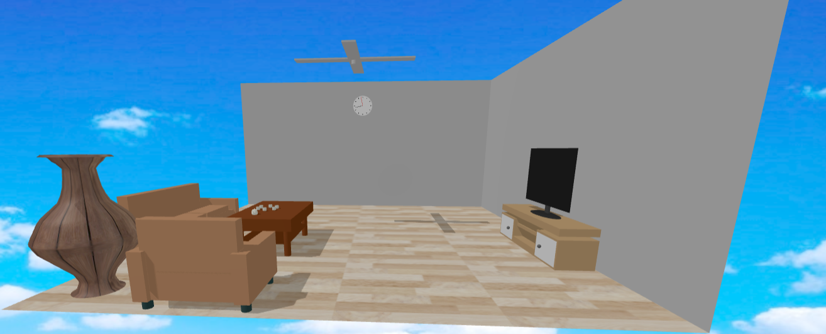
Living room

Slide 6
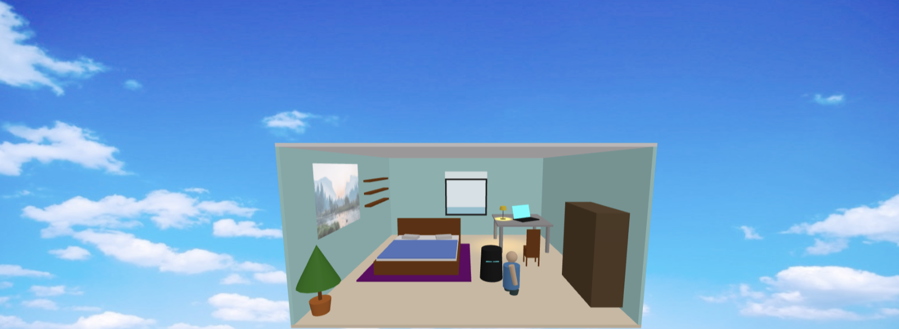
Bedroom

Slide 7
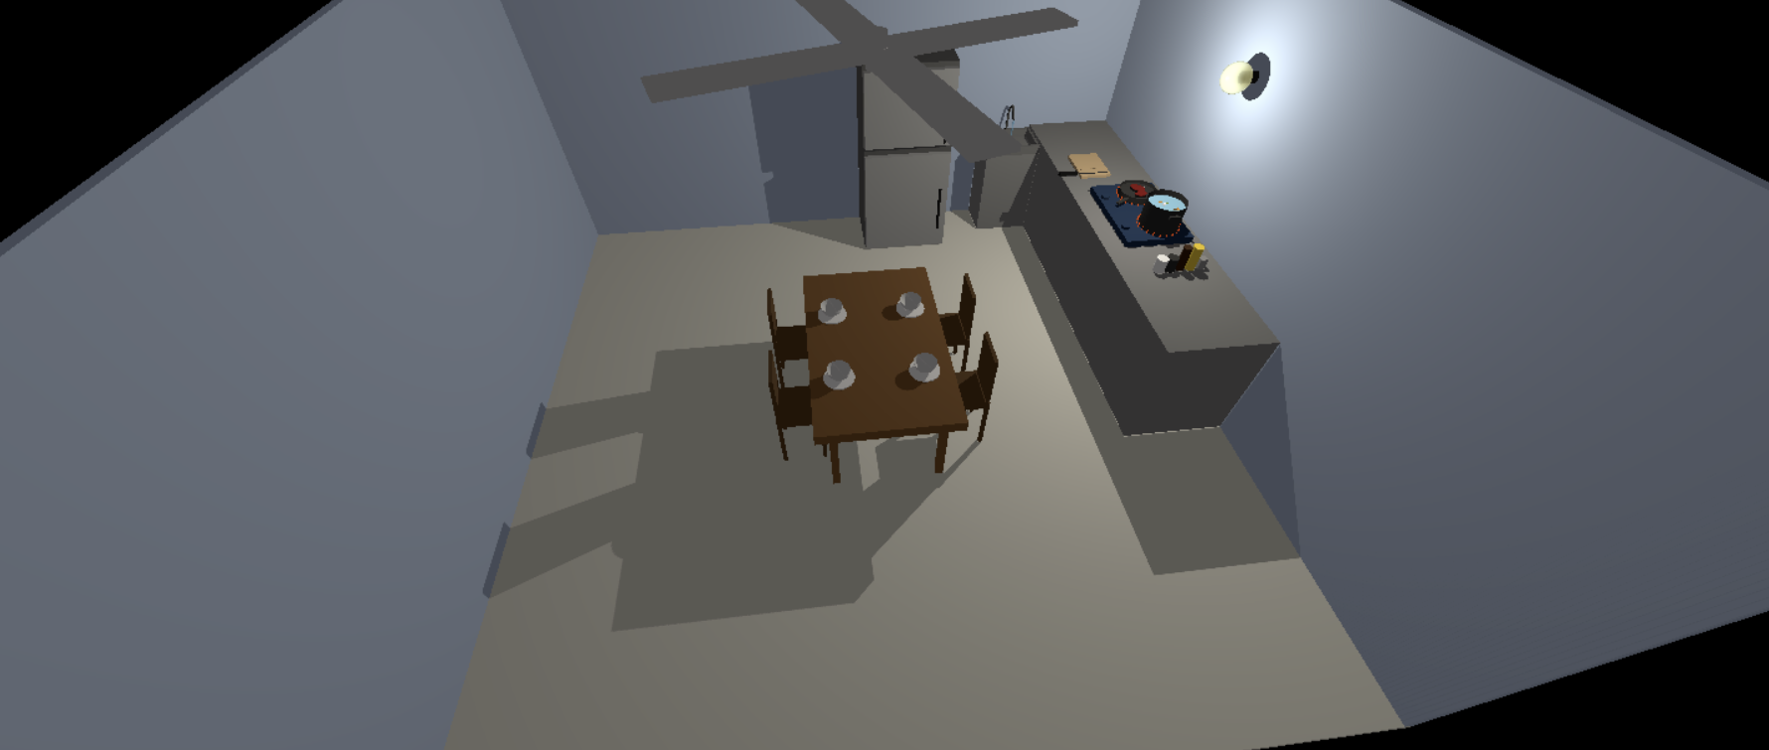
Kitchen

Slide 8
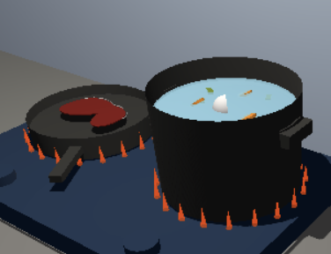
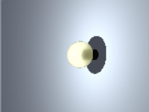
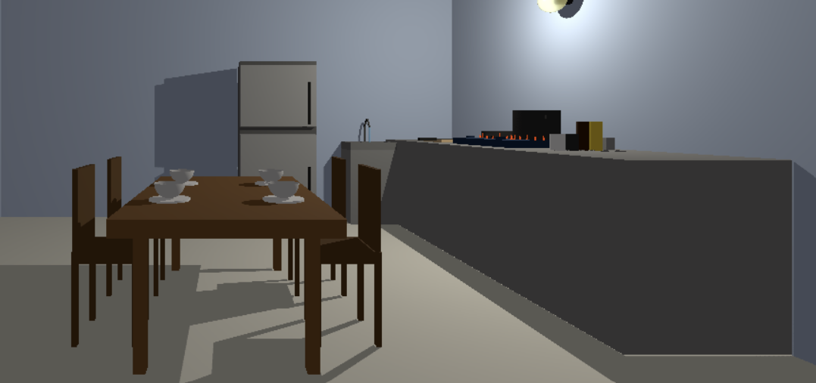
Kitchen
-Flame rings flicker Math.sin(t)
-Water boil Math.sin(t)
-Sizzling sound
-Boiling water sound
-PointLight at the light bulb
-Ambient light
-2 cameras, switch by key 'c'
-OrbitControls for camera2

Slide 9
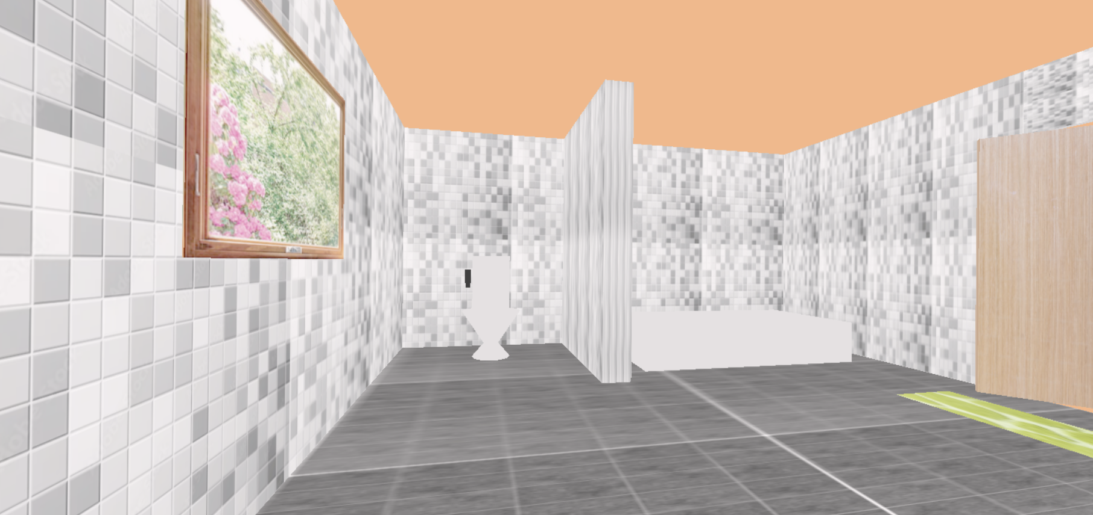
Bathroom – Page 1
Project maker:
Bui Hoang Giang

Slide 10
Bathroom
To build an interactive 3D bathroom model with realistic geometry.
Key components
Interactive Features
Press E to open/close the door
Navigate the scene with W/A/S/D keys and mouse controls
Area | Objects
Room Structure | Floor, walls, door, window (BoxGeometry)
Furnishings | Toilet, bathtub, cabinet (Box, Cone, Plane geometries)
Fixtures | Shower system, sprayer, faucet (Cylinder, Box geometries)

Slide 11
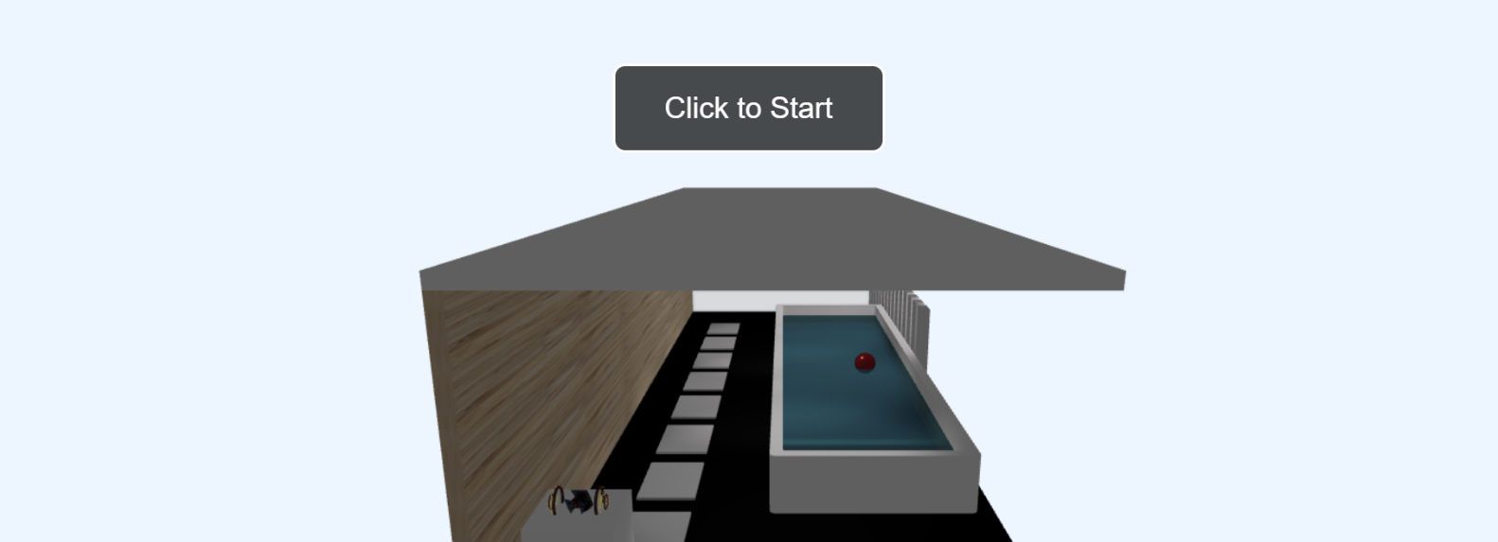
Swimming pool
Components detail
BoxGeometry: For walls, ceilings, floors, panels, planters, stepping stones, and parts of the towel rack.
PlaneGeometry: For flat surfaces like the main floor and pool bottom.
SphereGeometry: For bubbles and the floating ball.
CylinderGeometry: For towel rack bars and supports.
ShapeGeometry & ExtrudeGeometry: For custom forms like the rounded pool and water surface.

Slide 12
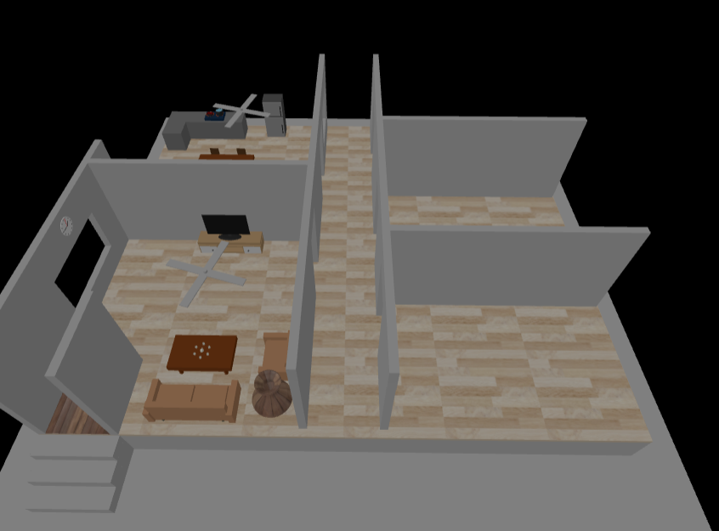
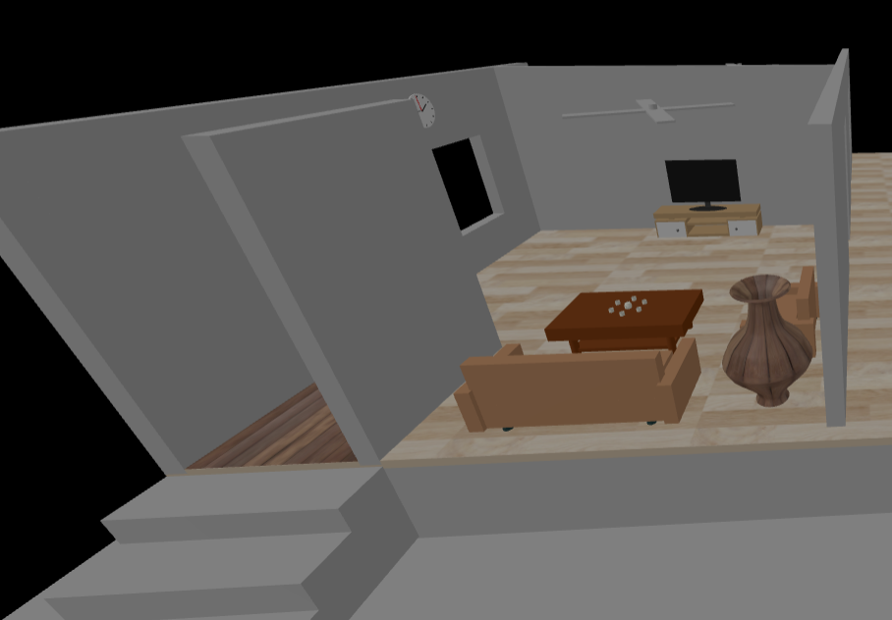
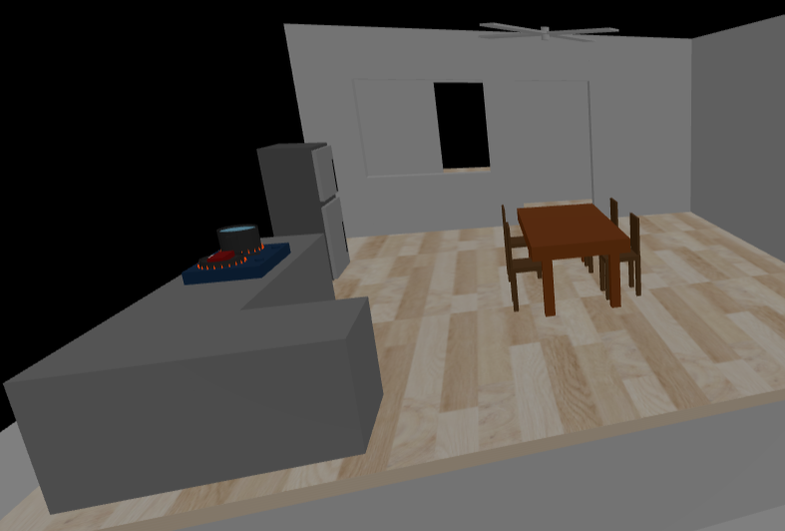
House

Slide 13
THANK YOU !

